Slide 1
Material mind and spiritual mind Lower chakra and higher chakra

Slide 2
Kings David and
King Solomon.
דָּוִד=beloved and שְׁלֹמֹה=
Man of peace
Father and Son.

Slide 3
1 Kings 10:14 Solomon’s annual revenue was 666 talents of gold
1 Rois10: 14 Le poids de l'or qui arrivait à Salomon chaque année était de six cent soixante-six talents d'or.

Slide 4
The bible is simply an allegoric book that describes the law of Yahweh among humans.
These two kings David and Solomon are the perfect allegoric of the two parts of personalities of humans.
Today we will concentrate more on Solomon

Slide 5
David was surrounded by war on all sides and could not build the temple of Elohim.
Solomon whose name means peace in Hebrew was the one built the temple of Elohim

Slide 6
Right away we have an understanding, this represents each of the mind where the wars rage the temple will never be constructed within, but where there is peace, the temple can be

Slide 7
Solomon is a part of us that is very interesting, because after he built the temple, he became very distracted by many other things.
He became distracted by physical things around him. And he turned away from the temple.

Slide 8
We all desire to have things, but when we depend on our lower selves then, we are Solomon and suddenly even though we built the temple, we are too busy for it. We forget where it is, and even we know where it is, but we are too busy to go there

Slide 9
For instance, we have prayer meeting only one hour on Friday, people are too busy to come because they have too many other things to care for

Slide 10
We need to see what happen to Solomon in this allegory, something came between him and Elohim, meaning the divine mind.
And everything that happens, Yahweh loves us so much and He has an extreme clever and beautiful way of identifying it

Slide 11
1 Kings 10:14 Solomon’s annual revenue was 666 talents of gold
1 Rois10: 14 Le poids de l'or qui arrivait à Salomon chaque année était de six cent soixante-six talents d'or.

Slide 12
Pay close attention to the income of Solomon 666 talents of gold.
666 is the identity of Solomon, the wisdom, 6 + 6 + 6 = 18 = 1 + 8 = 9
which is consciousness, it is either it’s the high or low consciousness, it has nothing to do with money

Slide 13
When 9 is lower consciousness, it is the number 9, upside down which becomes
number 6.
And pay close attention to this

Slide 14
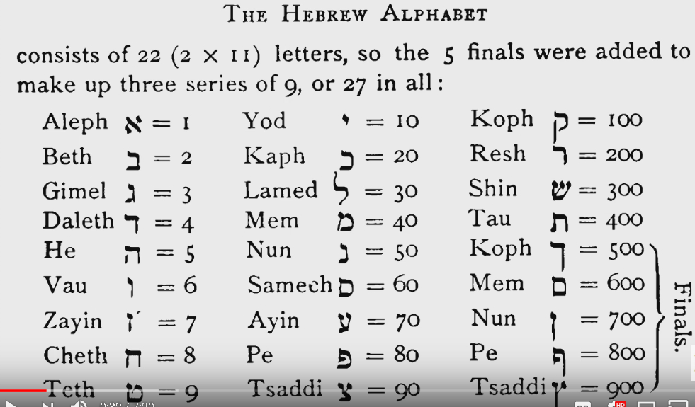
Solomon in Hebrew is שְׁלֹמֹה=Man of peace
300 + 30 + 40 + 5 = 375
375 = 3 + 7 + 5 = 15
15 = 1 + 5 = 6

Slide 15
What We need to understand, it is either you are rich if you stay within the high consciousness or poor if we get to the bottom of your consciousness.
High consciousness it is to reach the high chakra or low consciousness, to stay at the 3 bottom chakras

Slide 16
In other words, it is either we know the spiritual law of vibration and put to work for us or we are ignorant or disobedient of it and it is working against us. Either way it is working tirelessly nonstop

Slide 17
666, the lower mind of Solomon, he was distracted by physical things around him and he neglected the temple, regardless he was the builder.
Take a look again, the wages that came to Solomon was 666 talents of gold.

Slide 18
In my version of the book, the translator added a footnote as the 666 talents of gold represent 49,950 pounds, because to him one talent weighed about 75 pounds. Which is the amount of $127 million and 872 thousand dollars

Slide 19
He completely missed the whole allegoric that is in the book.
They missed the 666 which is the lower mind.
This book is an amazing thing if you can decipher the message divinely that is written for us.
The bible is a book of code and revealed to whoever Yahweh had chosen.

Slide 20
Everything created came from our mind. And Yahweh made sure to give us the tools to create everything we want.
It is all about the mind.
Solomon says in Prov. 23:7 man is the exact creation of his mind. Vs 7 l’homme est la production de sa pensée

Slide 21
Prov. 4:23 Above everything else guard your heart, because from it flow the springs of life.
Prov.4: 23 Garde ton cœur plus que toute autre chose, Car de lui viennent les sources de la vie.
Meaning, all creation came from the mind

Slide 22
666 talents of gold had nothing to do with money.
Let’s see the reason why Yahweh used the 666 code to revel his message to us.

Slide 23
Let’s go to 1 Kings 11:1 King Solomon married(having sex) many foreign women VS. 1 Le roi Salomon était marié avec beaucoup de femmes étrangères.
Foreign woman is a mystical symbol

Slide 24
A foreign woman is a lower aspect of the divine mind.
It means the emotion

Slide 25
When you say emotion, you need to see the energy in motion, in movement, in vibration.
It means the direction you give to your vibration. That’s why Elohim calls it strange woman

Slide 26
Something that is strange, it is unknown and for Yahweh, everything is well-known.
When you see bridegroom, it is stand for higher consciousness, spiritual wisdom, sexual energy transmutation

Slide 27
In verse one of chapter 11, it says king Solomon loved many strange women.
As a recall, remember we are talking about Solomon who built the temple of Yahweh

Slide 28
Let’s see Prov. 2:16 delivering you from the strange woman.
VS. 16 Pour te délivrer de la femme étrangère

Slide 29
Meaning the thought that came from the lower chakra, the seduction of the physical world

Slide 30
Solomon had wisdom, received from the higher realms, mind.
Do not visualize someone by the name of Solomon, it is all about you

Slide 31
You had wisdom since the creation and by distraction, misleading, misinformation, we lost it.
We got down to the lower consciousness. And life becomes nearly impossible to enjoy anything

Slide 32
Notice in prov. 2:16 the strange woman has seductive words and if you are taking direction from her, you will be misled. It will be trouble in all aspect of your life

Slide 33
It was never about a man named Solomon who had 1000 women to enjoy sex.
Billions of people for thousands of years came on earth, why David, Solomon, Moses, Abraham etc…

Slide 34
It is all about you and the divine consciousness. You and your life and things around you.
Are you attractive to them or are they attractive to you? Which one do you prefer?

Slide 35
Let’s go to 1 Kings 11:2 all of them from nations that Yahweh had ordered the Israelis, “You are not to associate with them and they are not to associate with you, because they will most certainly turn your affections away to follow their gods.” Solomon became deeply attached to them by falling in love

Slide 36
1 Rois 11 Vs. 2 appartenant aux nations dont Yahweh avait dit aux enfants d’Israël : Vous n'irez point chez elles, et elles ne viendront point chez vous ; elles tourneraient certainement vos cœurs du côté de leurs dieux. Ce fut à ces nations que s'attacha Salomon, entraîné par l'amour

Slide 37
It’s all about the lower mind. Each and every time your mind goes to the strange stuff, you should drop everything you are doing to go quickly into meditation.
Again, we are talking about Solomon who built the temple and now left it behind

Slide 38
It is not a physical story here, it is simply an allegory. Maybe the temple was built by Solomon, but you have nothing to do with a temple that was built for Yahweh, but the message He left for you to understand the importance of raising your vibration to the higher consciousness

Slide 39
Now here is the part I like the most in this story of Solomon. Chapter 11:3 He had 700 princess wives and 300 mistresses who turned his heart away from the Elohim.
1 Rois 11VS 3 Il eut 700 princesses pour femmes et 300 concubines ; et ses femmes détournèrent son cœur d’Elohim

Slide 40
Do you honestly think one person had 700 legal wives and 300 illegal women simultaneously?
Let’s be honest how did he remember all the names?
How many children did he have?

Slide 41
What vitamin did he take daily to keep up with 1000 women?
For one of his woman to have sex once a year with him, he had to make love to nearly 3 women daily and nonstop for 365 days. Do you believe that is possible to a human being?
After 700 legal women, it was not enough, he had to have 300 more illegally?

Slide 42
700 princess wives are the 7 chakras, they are precious to human being.
They are the 7 energy centers of every human being. Once you can get access to them easily, you reach the high consciousness, they are your wives everything will be provided to you by every one of them

Slide 43
But if you feel comfortable to stay at the 3 lower chakras, if you are stuck at the strangers, at the illegal concubines, the mistresses. They are not legal, you have to leave them.
Look at all the books, psalms, job, etc… the 7 is always combined with a 3.

Slide 44
Because in meditation which you have to do, there are 7 chakras, if you stuck at the first 3, you will get only and exclusively trouble
Why 7 and 3, because that number 10 means completeness

Slide 45
The fastest computer in the world is built only with 1 and 0. There is no other number and it is called binary number

Slide 46
Now when you read verse 4, and continue, you see Solomon turned his love away from Yahweh and his heart was not devoted to Yah.
Again, it’s all about you and your thought in meditation. When you know how to meditate by concentrating on your 7 chakras, to overcome every one of them until you get to the last one ( crown chakra), you will eat of the tree of life that is in Elohim’s paradise

Slide 47
When you can turn off your mind of the outside world and open it to your inside world meaning your 7 chakras. You are fully in the presence of Elohim

Slide 48
You have to take the identity of those characters in the book as part of your brain

Slide 49
Look at 1 kings 11:7 Later, Solomon even constructed a high place on the mountain east of Jerusalem that was dedicated to Chemosh, that detestable Moabite idol, and to Molech, the detestable Ammonite idol------------------------Alors Salomon bâtit sur la montagne qui est en face de Jérusalem un haut lieu pour Kemosch, l'abomination de Moab, et pour Moloc, l'abomination des fils d'Ammon

Slide 50
The word Chemoch in Hebrew כְּמוֹשׁ =the destroyer.
Let’s not be illusive, we are talking about Solomon, who was with Yahweh his entire life, he became king of Israel the people of Yahweh and he was the builder of the temple of Jerusalem.
Solomon built a high place for the god of the Moabites.
If you take it literally, you will say that Solomon was serving Yahweh and another god

Slide 51
No, it is because the characters in the book are about you and only you.
The explanation of this is that the mind of Solomon was consumed by the strong desires of this world that will eventually destroy him.
He built the temple but he could not sustain it.
We know where the temple is, we built it, but we are too much preoccupied by the desires of this world and we cannot go back to the temple, then we use excuses to go to other gods

Slide 52
But eventually we will be destroyed. Not after death, it is and illusion after your physical death.
The time is now.
Not being spiritual is a destruction, it will destroy you, your family, your health. It will be chaotic.
Do yourself this big favor, turn of your left brain and do your best to open the right one.
You have to come down the mountain of Chemosh and go back to the temple of Yahweh. Otherwise whatever you do, Chemosh will destroy you, he will eat you alive

Slide 53
Regardless who you are, what school you went to, what church you go to, Chemosh will eat you alive unless you come down his mountain and raise your vibe to Yahweh.
It is all about your mind, are you using the left or the right one?
Using the left brain is to focus on your first 3 chakras and to use the right one is to overcome the 3 chakras and get higher until you reach your crown.
From there you will eat from the tree of life that is in the paradise of Elohim.

Slide 54
Let’s read 1 Kings 11:11 so the Yahweh told Solomon, “Because you have done this and haven’t kept my covenant and statutes that I commanded you, I’m going to tear the kingdom from you and give it to your servant---------------------Et Yahweh dit à Salomon: Puisque tu as agi de la sorte, et que tu n'as point observé mon alliance et mes lois que je t'avais prescrites, je déchirerai le royaume de dessus toi et je le donnerai à ton serviteur

Slide 55
How many times have you heard a king becomes the servant of his servant?
Never, because it is an allegory about you and your obsession to this world.
Solomon is you, the temple is your attention to the spiritual world, (your high consciousness) and Chemosh is your low vibration (the obsession of this world)

Slide 56
The point of this story is that when you give your mind over to the glory and the beauty of divine meditation will give you good things.
Before you say you want something, it was already prepared for you. The second you simply say you want something, it will be provided to you shortly

Slide 57
May Yahweh
Bless You All

