Slide 1
The meaning of 666 and 144,000 in the bible

Slide 2
Revelation 13:18
In this case wisdom is needed: Let the person who has understanding calculate the total of the beast, since it is a human multitude, and the sum of the multitude is 600, 60, and six

Slide 3
Apocalypse 13:18
C'est ici la sagesse. Que celui qui a de l'intelligence calcule le nombre de la bête. Car c'est un nombre d'homme, et son nombre est six cent soixante-six.

Slide 4
it is not about numbers, but it is either higher consciousness or lower consciousness. Which is symbolized by the number 9 in the bible.
666 is 6 + 6 + 6 = 9
It is either you raise your vibration from Lower chakra to Higher chakra or you stay at the lower chakra.
If you decide to stay at the lower chakra, your number is 666 meaning your life will be like a gigantic animal, controlled by a tiny man. Like a big elephant in a circus

Slide 5
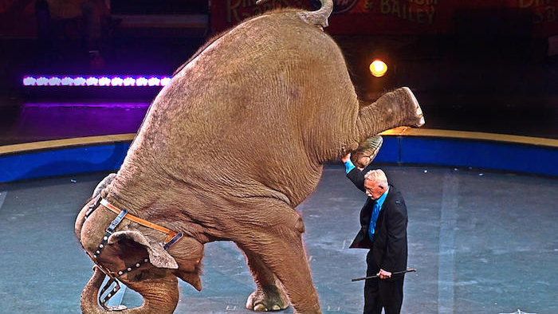

Slide 6
An African elephant weight is 13,000 lbs.
666= 9 meaning lower consciousness, it means divine ignorance. Manipulation allowance.

Slide 7
Revelation 7:4
4 I heard the number of those who were sealed: 144,000. Those who were sealed were from every tribe of Israel:
Apocalypse 7:4
Et j'entendis le nombre de ceux qui avaient été marqués du sceau, 144,000, de toutes les tribus des fils d'Israël

Slide 8
144000 is 1 + 4 + 4 =9 , marks a group of people who reach higher consciousness will dominate everything, meaning they will have answers to every situation, everything they ever want will be at their fingerprint effortlessly. They are people who are conscious about raising their vibration from the lower chakra to the higher chakra

Slide 9
Number 9 in the bible is all about divine consciousness. Higher or lower

Slide 10
John 21: 6 He told them, “Throw the net on the right hand side of the boat, and you’ll catch some.” So they threw it out and were unable to haul it in because it was so full of fish
Jean 21:6 Il leur dit: Jetez le filet du côté droit de la barque, et vous trouverez. Ils le jetèrent donc, et ils ne pouvaient plus le retirer, à cause de la grande quantité de poissons

Slide 11
The net had to be casted to the right side, meaning wisdom, enlightenment. Spiritual power

Slide 12
John 21:11
11 So Simon Peter went aboard and dragged the net ashore. It was full of large fish—153 of them. And although there were so many of them, the net was not torn

Slide 13
Jean 21:11
11 Simon Pierre monta dans la barque, et tira à terre le filet plein de 153
grands poissons; et quoiqu'il y en eût tant, le filet ne se rompit point

Slide 14
about 153 fishes it is
1 + 5 + 3 = 9 it is about high consciousness, using the right hemisphere where the divine wisdom lies down

Slide 15
Let’s go back to
Rev. 11:3 I will give my two witnesses who wear sackcloth the authority to prophesy for 1,260 days
Apocalypse 11:3
3 Je donnerai à mes deux témoins le pouvoir de prophétiser, revêtus de sacs, pendant 1,260 jours

Slide 16
The two witnesses will prophesy, meaning they will see with spiritual power. They will have psychic abilities. They will do that for 1,260 days
1+ 2+ 6 + 0 = 9

Slide 17
9 is the symbol of higher or lower consciousness. Meaning it is either you see spiritually=higher consciousness you reach your higher chakra or you do not see spiritually, You see only with you 5 senses, you stay at the lower consciousness, you stuck on the lower chakra and your life will always be dramatic in every aspect until you die

Slide 18
That’s why Yahweh says His messengers are 7 stars in His right hand and the 7 lamps are the 7 churches

Slide 19
Revelation 1:20
The secret meaning of the seven stars that you saw in my right hand and the seven gold lamp stands is this: the seven stars are the messengers of the seven churches, and the seven lamp stands are the seven churches

Slide 20
Apocalypse 1:20
le mystère des sept étoiles que tu as vues dans ma main droite, et des sept chandeliers d'or. Les sept étoiles sont les anges des sept Églises, et les sept chandeliers sont les sept Églises

Slide 21
7 Stars
Every star is illuminated because they can overcome every one of the chakra easily. Every star of Yahweh unblocks all chakras before getting access to Him. And Yahweh responds only to the star that overcomes every one of the chakras

Slide 22
Right hand of Yahweh.

Slide 23
Right of Yahweh
is divine wisdom, enlightenment

Slide 24
Hand of Yahweh
marks His protection, strength, authority given to His messengers. He said to Isaiah 41:13 “For I am Yahweh, your Elohim, who takes old of your right hand, who says to you, ‘Don’t be afraid. I’ll help you

Slide 25
Ésaïe 41 :13 Car je suis Yahweh, ton Elohim, Qui fortifie ta droite, Qui te dis: Ne crains rien, Je viens à ton secours

Slide 26
Being at the right hand of Yahweh is His permission to sit on His throne. Meaning He shares His power with that person.

Slide 27
He says to Yahshua in
Luke 20:42-43 Because David himself in the book of Psalms says, ‘Yahweh told Yahshua, “Sit at my right hand, 43 until I make your enemies a footstool for your feet

Slide 28
Luc 20:42-43
42 David lui-même dit dans le livre des Psaumes: Yahweh a dit à Yahshua: Assieds-toi à ma droite,
43 Jusqu'à ce que je fasse de tes ennemis ton marchepied.

Slide 29
The minister is the one illuminated by Yahweh to teach spirituality to His people, he is helping the church to raise the vibration from the lower chakra to the higher chakra. That’s why he is placed in the right hand of Yahweh, meaning he is guided by spiritual and divine knowledge

Slide 30
Some Important facts about number 9
9 is a unique number that separate himself from the other numbers. In Hebrew every letter has a numerical value, it is called Gematria

Slide 31
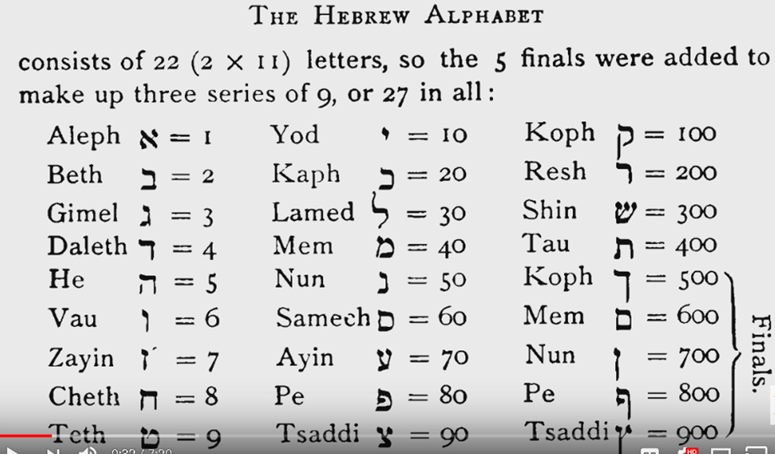

Slide 32
Number 9 is the signature of Yahweh. The first human created was called Adam אדם

Slide 33
He was the most perfect person in creation in every way. Adam represents the number system from 1 to 9.
Adding all numbers from 1 to 9, it will equal 45 and 45 is 4 + 5 = 9. Adam in Gematria also equal 9. It is 40 + 4 + 1 = 45 which is 9.

Slide 34
Truth is אֶמֶת which is 400 + 40 + 1 = 441 which is 9

Slide 35
Take any number and add 9 to it, the number comes back.
Example 5+9 =14 and 14 is 1+4 =5 is the number we started with. It works with any number

Slide 36
Now take any number and multiply it by 9. The sum will always equal to 9.
Example. 6 X 9 = 54 and it is 5 + 4 = 9. It works with any number

Slide 37
Now take any number and subtract it by the sum of itself, it will yield 9.
Example: 33 – 6 = 27 it is 2 + 7 = 9.
Another Example: 4352 = 4 + 3 + 5 + 2 = 14. 4352 – 14 = 4338 and 4338 is 4 + 3 + 3 + 8 = 18 which is 9

Slide 38
9 is truth, it is life it is the signature of Yahweh.
There are 9 months to pregnancy, 1440 minutes to a day which is 9.
Water in Hebrew is מַיִם
And this word means life. And it is 40 + 10 + 40 = 90 which is 9

Slide 39
People who know the significance of number 9 always add it to their price for success. Now go to the stores, watch the advertisings and pay attention to number 9, you will be amazed

Slide 40
When a price has two successive 9’s, the first is for success and the second works as hypnosis. it is to avoid all rejection.
Like $19.95, $29.99, etc…

Slide 41
May Yahweh
Bless You all

