Slide 1
The Hidden meaning of The Seven Churches in the bible

Slide 2
Yahshua says in Revelation 1:11
“Write on a scroll what you see, and send it to the seven churches: Ephesus, Smyrna, Pergamum, Thyatira, Sardis, Philadelphia, and Laodicea.”

Slide 3
Apoc. 1 :11 Qui disait: Ce que tu vois, écris-le dans un livre, et envoie-le aux sept Églises, à Éphèse, à Smyrne, à Pergame, à Thyatire, à Sardes, à Philadelphie, et à Laodicée

Slide 4
Then I turned to see who was talking to me, and when I turned I saw seven gold lamp stands

Slide 5
Je me retournai pour connaître quelle était la voix qui me parlait. Et, après m'être retourné, je vis sept chandeliers d'or

Slide 6
16. In his right hand he held seven stars, and out of his mouth came a sharp, two-edged sword. His face was like the sun when it shines with full force

Slide 7
¹⁶ Il avait dans sa main droite sept étoiles. De sa bouche sortait une épée aiguë, à deux tranchants ; et son visage était comme le soleil lorsqu'il brille dans sa force.

Slide 8
Yahshua explains in Revelation 1:20
20 The secret meaning of the seven stars that you saw in my right hand and the seven gold lamp stands is this: the seven stars are the messengers of the seven churches, and the seven lamp stands are the seven churches

Slide 9
7 candlesticks = 7 churches
7 stars = angels of the 7 churches.

Slide 10
Let’s summarize
Each candlestick is a church
Each star is an angel of the 7 churches.
Let’s take a look at the seven churches in your body again

Slide 11
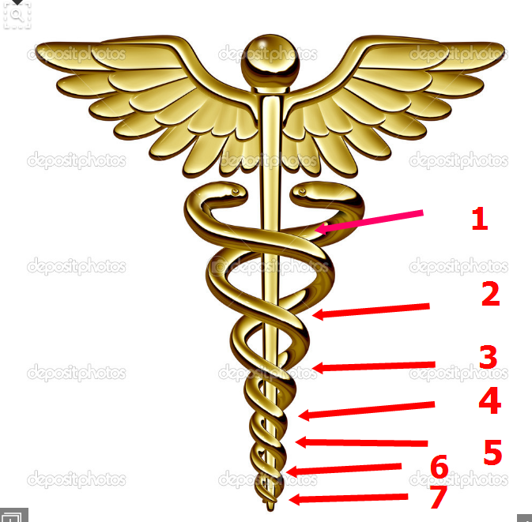

Slide 12
If you know how to overcome each one of the churches, you will be an angel of Elohim

Slide 13
I- Elohim had specially designed human body to set him apart from the animals.
A- The seven churches are located in our body

Slide 14
II- Let’s go to revelation 4:1
After these things, I saw a door standing open in heaven. The first voice that I had heard speaking to me like a trumpet said, “Come up here, and I will show you what must happen after this

Slide 16
A- The seven churches are the seven steps that we all must climb to get to heaven.
1- Man, fall from perfection and get stuck to the first two chakras. Root and Sacral chakras

Slide 17
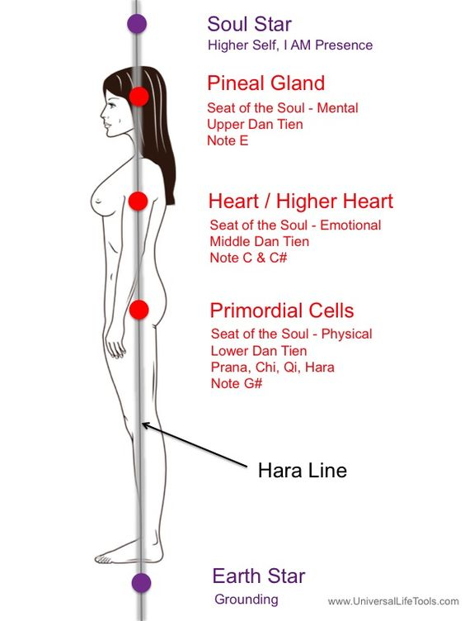

Slide 18
When you get to the Church of Laodicea or the crown chakra, you will be Angel or I am, meaning the presence of the power of Yahweh that is in you.
I am, is not physical, but spiritual. Today when you say I am, you are talking about your physical body and when Yahweh says “I am”, He is talking about His power and the Presence of I am, is in You. He specifically designed your body for that

Slide 19
Elohim sits at the primordial cells.
And Yahweh specifically says in 1 Cor. 6:19 You know that your body is a sanctuary of the Holy Spirit who is in you, whom you have received from Elohim, don’t you? You do not belong to yourselves

Slide 20
Ne savez-vous pas que votre corps est le temple du Saint Esprit qui est en vous, que vous avez reçu de Elohim, et que vous ne vous appartenez point à vous-mêmes?

Slide 21
2- Hinduism & Buddhism already understand the spiritual truth behind the 7 Spiritual centers and their purpose.
3- Each church has a purpose in you. Imperfection causes us to stay far away from Elohim

Slide 22
B- Let us mention this again and again and again. Yahshua says through Paul that the power of Elohim rest within you. Phil. 2:13 and His kingdom is in you and around you

Slide 23
1- His power is stimulated by the Pineal gland which opens up the right hemisphere of the brain.
2- It comes through a vibration of the spine which moves to 7 chakras.
a) We are simply talking about that is an energy inside of you that moves up the spine and lights up the right hemisphere of the brain

Slide 24
C- Elohim is sitting in your primordial cells, that’s why it is called the sacrum, your lower back, that’s your foundation.
1- Sacrum means holy place
2- The sacrum is the part of your body used to sit on. Now we are at the very lowest base of your desire nature

Slide 26
The church of Ephesus is your root chakra Let’s see Rev. 2:5 Therefore, remember how far you have fallen. Repent and go back to what you were doing at first. If you don’t, I will come to you and remove your lamp stand from its place—unless you repent.

Slide 27
Vs 6 But this is to your credit: You hate the actions of the Nicolaitans, which I also hate. Tu as pourtant ceci, c'est que tu hais les oeuvres des Nicolaïtes, oeuvres que je hais aussi

Slide 28
3- Now let us see what the Nicolaitans did.
1- They failed to worship. Meaning they were obsessed with the lower physical desires.
a) Everything was about food, money, sex, power over material needs

Slide 29
b) The name Nicolaitan comes from the Greek word Nicolah meaning "let us eat," as they often encouraged each other to eat things offered to idols and they encouraged sexual immorality.
c) They got it from the doctrine of Balaam " who taught Israel "to sin by eating food sacrificed to idols and by committing sexual immorality

Slide 30
d) Obsession for those things have gotten you and me and the rest of this world in so much trouble
e) So Yahshua told John to write to the church of Ephesus to stop their obsession of the lower chakra to gain their consciousness to raise their vibration to the higher consciousness

Slide 31
f) It doesn’t matter how long you have been praying, meditating, going to church, if you cannot use the sexual energy from the lower chakra to the higher chakra, you will never get to heaven.
g) Heaven is your higher consciousness. “ The Crown chakra”.

Slide 32
h) If you stay obsessed with the lower chakra, your light is off and there is no prayer or meditation that can help you.
i) You can try to be the best person by giving away everything you have to needy people, that will not help you

Slide 33
j) You must turn on the light. And that’s the only way to get to heaven.
k) You must practice to close your physical eye and open your third eye by directing your sexual energy to your higher chakra to gain higher consciousness.
l) Yahshua says in Mat. 6:22 “when you learn how to see with your third eye, your whole body will be full of light”

Slide 34
2- It does not matter what you think, you cannot change the order Elohim had created things. You only must follow the order or it will never work for you.
3- You buy a car to drive you around, it does not matter if you think the brake pedal should be on the right and start pressing the gas pedal for the brake pedal it simply will not work for you. Acting that way, your own car will hurt you

Slide 35
Your body is the temple of Elohim, He designed it the way he wanted it and you are clearly told that you do not own yourself. But Elohim does.
You have to learn to use your body the way He had designed it or it will hurt you again and again and again.
So you have to learn to raise your vibration to get to him

Slide 36
Let’s see Rev. 2:7
‘Let everyone listen to what the Spirit says to the churches. I will give the privilege of eating from the tree of life that is in Elohim’s paradise to everyone who overcomes

Slide 37
Que celui qui a des oreilles entende ce que l'Esprit dit aux Églises: A celui qui vaincra je donnerai à manger de l'arbre de vie, qui est dans le paradis d’Elohim

Slide 38
The word churches does not mean a group of people singing, praying together, the word churches stands for the 7 chakras.
That’s why Yahshua told John to write whoever has ear to listen, meaning whoever has a good understanding.

Slide 39
Everyone has ears, but in this context, it is not literally ear, but the ability to understand.
If you cannot see the utmost importance of knowing your 7 chakras are the seat of your soul

Slide 40
Your 7 chakras are the 7 churches, you are trapped to live the life given by man instead of the one given by our creator.
We all have the power to understand how important it is to be true to ourselves.
Stop all negativity. The churches are in ourselves and the messages are all for us and about us.

Slide 41
Let’s see again the verse Rev. 2:7 “I will give the privilege of eating from the tree of life that is in Elohim’s paradise to everyone who overcomes”
Tree of life is divine knowledge. It’s from the root chakra to the crown chakra

Slide 42
If you can overcome every one of them, you will get access to Elohim’s paradise

Slide 43
Let’s see the meaning of
Tree of life.
Gen. 2:8 Yahweh, Elohim planted a garden in Eden, toward the east, where he placed the man whom he had formed

Slide 44
Let us see together the location Yahweh had planted the garden

Slide 45
“Toward
the
East side”.

Slide 46
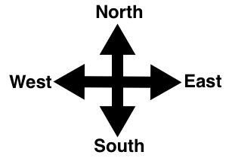

Slide 47
Any time you see East, it is located on the right side.
He is talking about the right hemisphere of the brain.
We are using less than 5% of the brain because we are using the left side of the brain and the right side stays dormant.
The right hemisphere of the brain is more for understanding, enlightenment, wisdom

Slide 48
The left side controls the right side of the body and 99% of the world is righty.
The left side of the brain controls the right side of the body.
Most of the inventors of this world are lefty. Because they are more spirituals than the rest of the world. Like Albert Einstein, Isaac Newton, and Benjamin Franklin

Slide 50
Artists
Leonardo Da Vinci Paul Klee Michelangelo Buonaroti Henri de Toulouse Lautrec Peter Paul Rubens

Slide 51
Actors
Amitabh & Abhishek Bachchan Drew Barrymore Kim Basinger Kenneth Branagh Pierce Brosnan Jim Carrey Charlie Chaplin Tom Cruise

Slide 52
Robert De Niro Matt Dillon Morgan Freeman Judy Garland Whoopi Goldberg Angelina Jolie Nicole Kidman Val Kilmer Lisa Kudrow Marilyn Monroe

Slide 53
Mary-Kate & Ashley Olsen Sarah Jessica Parker Brad Pitt Keanu Reeves Julia Roberts Jennifer Saunders Sylvester Stallone Scarlett Johansson Chewbacca the Wookie

Slide 54
History
Alexander The Great
Albert Einstein
Jack The Ripper
Napoleon Bonaparte
Julius Caesar
Aristotle
Neil Armstrong
Henry Ford
Marie Curie
Joan of Arc
Helen Keller

Slide 55
Politics
Winston Churchill Barrack Obama
Technologies/ICT
Bill Gates Steve Jobs Steve Wozniack

Slide 56
Sport
Wasim Akram Sir Bobby Charlton Diego Armando Maradona Pele Lionel Messi Paula Radcliffe Jimmy White Mark Williams John McEnroe Martina Navratilova Greg Rusedski Babe Ruth

Slide 57
Verse 9, The tree of life was also in the middle of the garden.
The tree of life is simply the divine wisdom

Slide 58
In Revelation, 2:7 Yahweh says “I will give the privilege of eating from the tree of life that is in Elohim’s paradise to everyone who overcomes”

Slide 59
Yahshua meant to say: if you can overcome every chakra to get to heaven, He will personally make you divinely wise.
You will be guided by Yahweh messengers

Slide 60
Tree of life is simply divine knowledge, divine wisdom which you can get only by climbing from the root chakra to the crown chakra.
Let’s see another example which can light you up greatly

Slide 61
Luke 19:3-6 ³ He was trying to see who Yahshua was, but he couldn’t do so due to the crowd, since he was a short man. 4 So he ran ahead and climbed a sycamore tree to see Yahshua, who was going to pass that way. 5 When Yahshua came to the tree, he looked up and said, “Zacchaeus, hurry and come down! I must stay at your house today.” 6 Zacchaeus came down quickly and was glad to welcome him into his home

Slide 62
b) That is a story well organized to mislead you.
c) It is all symbolic. Pay close attention to the verse.
d) To see Yahshua, the short man had to climb a sycamore tree. He left the crowd stuck at the lower level and he went to the higher level so He could see Yahshua

Slide 63
e) 3 words are extremely important here. Short man, climb, sycamore tree.
f) Sycamore tree, in knowledge book it means truth, goodness.
g) We are short because we are stuck at the lower chakra

Slide 64
h) He climbs, because he had to get from the lower chakra to get to the crown chakra to see Yahshua.
i) When he gets to the crown chakra because he climbs. Then Yahshua decided to go to his house and be his guest

Slide 65
j) To see Yahshua face to face who is inside of you, you have to raise your vibration, you have to leave the base chakra and climb up to the crown chakra. There you will eat from the tree of life. In short, you will be divinely wise.
k) You will use your right hemisphere more than the left side.
l) You will be divinely advised

Slide 66
m) It is a promise to all of us. “To whom who overcomes”.
n) Every major religion in the world has this knowledge except Christianity, because of so much misleading information in this book so-called bible

Slide 67
2- To see Elohim face to face, you have to get out of your root chakra and get to the higher chakra, to the pineal gland so your body can be full of light. Mat. 6:22.
a) Yahshua says if you can see with your pineal gland, your whole body will be full of light.

Slide 68
b) If you can close your physical eyes and open your pineal gland, you will be full of divine knowledge

Slide 69
3- Let’s read Gen. 32:30. This is where Jacob was arguing, wrestling.
a) Jacob would later call that place Peniel, because “I saw Elohim face to face, but my life was spared

Slide 70
Jacob appela ce lieu du nom de Peniel: car, dit-il, j'ai vu Elohim face à face, et mon âme a été sauvée

Slide 71
b) Peniel in Hebrew פְּנִיאֵ֑ל (Peniel) from פָּנָה ( (panah) means face, turn and אֶל (EL) Elohim.
c) Peniel means see Elohim face to face

Slide 72
It means reach your higher consciousness. Let’s consider the word פְּנִיאֵ֑ל
And פָּנָה Let’s see their numeric value.

Slide 73
פְּ=80 נִ=50
י = 10 אֵ֑= 1
ל=30
80 + 50 + 10 + 1 + 30 =171
171= 1 + 7 + 1 = 9

Slide 74
Let’s consider the word in its numerical value פָּנָה
פָּ =80
נ = 50
ה= 5
80 + 50 + 5 = 135
135 = 1 + 3 + 5 =9

Slide 75
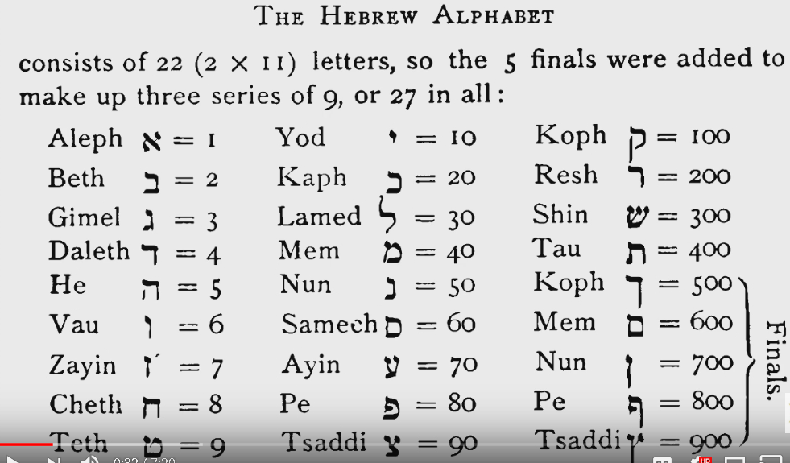

Slide 76
You can only see Elohim with your Pineal gland

Slide 77
III- Yahweh had given the Pineal gland to you in order to see him spiritually. Not with your naked eyes
A- Zacchaeus climbs the tree and sees Yahshua face to face.
1- Yahshua said if you practice the single eye, your body will be full of light.
2- Another word you will see things in their spiritual state before they come to be materialized

Slide 78
a) The single eye according to the ancients, is your pineal gland in the brain.
b) It is an organ in the brain like every other organ that all humans have.
3- The center of your brain is a sacred place according to the ancients.
4- The Hindus wear a dot in the center of their forehead to always remind them who they are, a spiritual being

Slide 80
B- Christianity has no idea about this truth and their religion is 100% from the Egyptians and the Chaldeans.
1- We can only see Yahweh with our third eye, and He says that he writes His name on our forehead, where in our pineal gland. And our head is a symbol of the first letter of His name

Slide 81
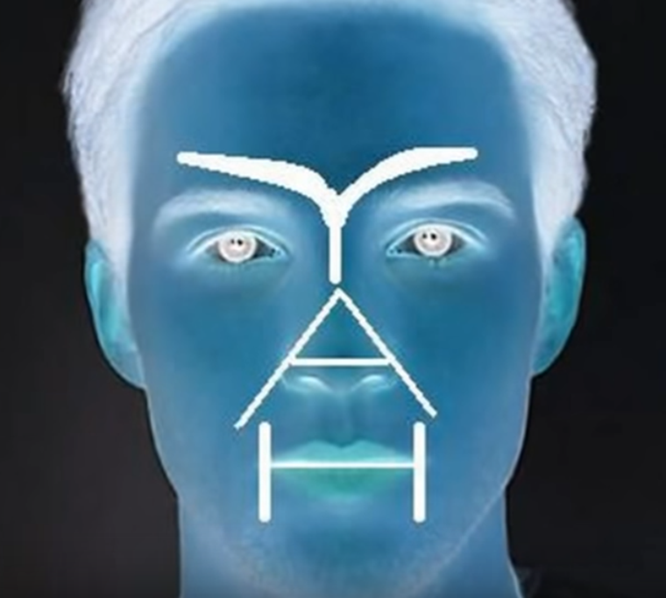

Slide 82
2- According to doctors in Richland Washington, when you activate the pineal gland of the brain, melatonin flows and it heals cancer cells and strengthens the immune system.
3- It is scientifically proven.
4- If you follow the instructions of Yahshua, your life will change 100% and will never be the same again

Slide 83
C- Zacchaeus is written for you to understand how to see Yahweh face to face, it is not about climbing a tree, but it is to meditate to raise your vibration from the root chakra to the crown chakra to see Yah face to face.
1- If you overcome all the chakras, you are promised to eat from the tree of life.
2- Number 7 is the signature of The master beings, the creator. This number shows in plain sight the power of Yahweh

Slide 84
Number 7 is the power of Yahweh
Number 9 is the knowledge of Yahweh

Slide 85
3- Everything in the bible is all symbols about humans, about the 7 chakras, about how to reach out to Elohim.
4- He asked Joshua to walk around Jericho’s walls 7 times to bring it down.
5- The story is written to show you how to reach Elohim, maybe it was never a literal fact, it is all about coming from your root chakra to reach you crown chakra to overcome every situation. To see the power of your creator manifested for you the exact way you want it.
6- Maybe there was never a man walking around a town and the walls came down

Slide 86
7- Maybe it was never a literal story but simply a symbolic story to wake you up, a story to be taught to humans to help them to raise their vibration to the 7 chakras.
8- It simply tells you if you raise your vibration from the root chakra to the pineal gland, you will see Yahweh face to face and if you raise it to the 7th chakra, the walls that keep you away from Elohim will be crashed down and you will eat from the tree of life that is in the garden of Yahweh

Slide 87
9- Elohim created 7 days and the sixth day is the moon it is symbolic to the 6th chakra, your pineal gland that’s why it gives melatonin and serotonin which allows you to sleep so you can communicate with Yahweh.
a) That’s why to see Yahweh, you must close your eyes and reach your pineal gland with your consciousness, you cannot see him with your naked eyes.
10- The 7th day is the Sunday, the crown chakra, it is the day of brightness. It is a representation of Yahshua. He is the Son of Yahweh and He is the Sun of Yahweh. The sun gives life to every living beings spiritually and physically, so does Yahshua

Slide 88
May Yahweh,
Bless You All

