Slide 1
Integrity

Slide 2
One of the ways to communicate with the power inside of you is to have integrity

Slide 3
Integrity is one of the great key to waken the seven sources of energy we all have in us. Some people call them chakras.
Without integrity, it is absolutely impossible to have a balance between spiritual life and human life

Slide 4
We all know that we are the spirit of Yahweh inside a human flesh.
That’s why Yahshua said in Mat. 4:4 “It is written, ‘Man shall not live by bread alone, but by every word that proceeds out of the mouth of God.’”
Human being is the finest piece of the creation and Yahweh is proud after this marvelous creation, that’s why He allowed human being to be like Him

Slide 5
And Yahweh used number seven as a sign to show His completion.
Number seven is truly the number of Yahweh’s divine authority and divine touch of perfection and completion.
He took 7 days to create the earth.
Seven continents that makes the world: Asia, Africa, North America, South America, Europe, Australia, and Antarctica

Slide 6
7 colors in a rainbow.
7 DIGITS ARE THE LIMIT OF HUMAN MEMORY thus 7 digits on our phone numbers.
7 notes on musical scale A B C D E F G / DO RE MI FA SOL LA SI
7 days in a week
7 seals, 7 trumpets, 7 bowls of wrath
7 letters to the churches in Asia Minor in the book of revelation.

Slide 7
Yahshua presented Yahweh (I Am) by 7 titles.
John 6:35 “I Am” The Bread of Life.
John 8:12: “I Am” The Light of The World.
John 10:9 “I Am” The Gate.
John 10:11 “I Am” The Good Shepherd.
John 11:25:” I Am” The resurrection and The Life.
John 14:6: “I Am” The Way, The Truth, and The Life.
John 15:5:” I Am” The True Vine”

Slide 8
Noah was ordered by Yahweh to enter in the ark seven days before the deluge.
Gen. 7:10
Yahweh had used a rainbow which has
7 colors to talk to Noah.
And the same seven colors of that rainbow are the exact same colors of the 7 sources of human energy

Slide 9
Let’s go back to
Mat. 4:4 “It is written, ‘Man shall not live by bread alone, but by every word that proceeds out of the mouth of God.’”

Slide 10
When Yahweh had created humans, he created 7 major spiritual sources and 7 medically recognized major regions of the human body to live by them.
They are :
Head
Thorax
Abdomen
2 arms
And 2 legs

Slide 11
Those are visible, because we can see them, we pay great attention to them.
But the non-visible ones, the seven spiritual ones are hurting us tremendously because they are hiding them from you.
This knowledge should be taught in school starting as early as elementary school

Slide 12
Teach your children, your neighbors, friends, parents, everyone you know.
That was one of Yahshua’s teaching when He was with us.
For someone to be spiritual, to be guided spiritually, to do things with accuracy. To have an IQ at the Highest level, you must pay attention to the seven spiritual sources we all have

Slide 13
They must be unblocked from the root chakra to the crown chakra for Yahweh to infuse them with energy for you from your crown chakra to the root chakra.
Yahshua had brought information on every one of them. Form the root chakra to the crown chakra

Slide 14
What is integrity?

Slide 15
Integrity is fulfilling the words you give to yourself and to others.
The second you give a word to yourself, your internal servant takes note and is waiting for you to do it. That is a part of Him that makes you like Him. Deut. 23:21When you vow a vow to Yahweh your Elohim, you shall not be slack to pay it; for Yahweh, your Elohim will surely require it of you; and it would be sin in you

Slide 16
The word Vow is in Hebrew נֶ֙דֶר֙(NêDêR).= A FREEWIL, PROMISE.
נֶ֙דֶר֙ is a noun from נָדַר (NADAR) the verb = a freewill to make a promise

Slide 17
Elohim is inside of you and inside of everyone.
When you say to yourself that you have to do something, you should not slack to do it.
When you give your word to someone, you should make it happen to the best of your ability.
Some people think being late to an appointment is nothing when it is a failure to fulfill your word and it is a sin if it is a lack of effort on your side

Slide 18
Yahweh is never late in fulfilling His word, vow, or promise. They are all synonyms.
Salomon said in Ecclesiastes 5:4 When you vow a vow to Elohim, don’t defer to pay it; for he has no pleasure in fools. Pay that which you vow.
You have to respect your word to activate Elohim who is sited at the bottom of your root chakra

Slide 19
Yahshua said in Mat. 5:37 But let your ‘Yes’ be ‘Yes’ and your ‘No’ be ‘No.’ Whatever is more than these is of the evil one.
Evil means opposition, contrary.
Integrity is all about your word fulfillment.
Regardless how small or big it is, you cannot slack to fulfill them.

Slide 20
You said to your mother, or your friend, I will call you tomorrow, if your memory is not that good, put it on a calendar to remind you so you can do it, that is part of you being the image of Elohim.
You told your husband/wife, you will be with him/her for the rest of your life in good and bad days, you will cherish, honor and take care of him/her. What happens today?

Slide 21
Is it because the body has changed? Is it because of age?
Why can’t you take the time to appreciate what you have in your hands today?
Do you know how much harm you are doing to yourself?
When you practice integrity.
Confidence in yourself will grow because people will believe in you.
People will take you seriously

Slide 22
People will trust you with sometimes their lives.
It does not matter how small it is, you must fulfill your word to wake up your Elohim.
If you say tomorrow you will wake up early to make a breakfast, you should do it. You cannot change it because you feel staying in the bed is better. You should not say it in the first place

Slide 23
When you see how much you don’t have confidence in yourself it is because of so many words you promised to yourself and others and you do not fulfill them.
Pay attention to those 3 verses Deut. 23:21When you vow a vow to Yahweh your Elohim, you shall not be slack to pay it; for Yahweh, your Elohim will surely require it of you; and it would be sin in you

Slide 24
Ecclesiastes 5:4 When you vow a vow to Elohim, don’t defer to pay it; for he has no pleasure in fools. Pay that which you vow.
Mat. 5:37 But let your ‘Yes’ be ‘Yes’ and your ‘No’ be ‘No.’ Whatever is more than these is of the evil one.

Slide 25
Everyone, including you was created at the image of Yahweh.
You have to be very phonetic about integrity.
You say you have to be there at 9:00, you have to be there a little before 9:00 regardless, not one second after 9:00 because you do not want Elohim to use it as a sin against you, and He will, there is no forgiveness that will change that

Slide 26
Your sources of energy (chakras) are connected to your thoughts and your words.
When you practice integrity, you will see the results immediately.
You will see how confident you are in making good stuff happened in your life.
You will see that a lot of people will come to you for help

Slide 27
And that is a sign that you are doing something right.
As you make integrity a part of your life, you will waken spiritual powers in you.
Why things you desire refuse to happen in your life?
Now go back to your life and see how many times you promise to yourself and to others things that you never fulfill.

Slide 28
You will physically see how amazing things will happen in your life by practicing integrity.
For instance, you may wake up and say I would like to have a great meal, but I do not want to cook nor go to any restaurant, few minutes later your parents or a good friend shows up on your door with a nice meal for you

Slide 29
How to start in
the path of integrity?

Slide 30
The first one to have a very high awareness of your thoughts and your words.
Any thought or word you are about to have for you and for others, you have to fulfill them.
If for any reason you know you cannot, do not engage.
If you made a mistake, ask for apology immediately before the due time.

Slide 31
The second thing to do is to go back to all the words you gave, as far you can go in the past and every one of them that you can fulfill, do the best you can. Make a list if you cannot remember them all.
And more importantly, don’t be scared, don’t feel any shame of fulfilling your words.
That way it is a great step in awaking your spiritual power

Slide 32
May Yahweh,
Bless You All

Slide 33
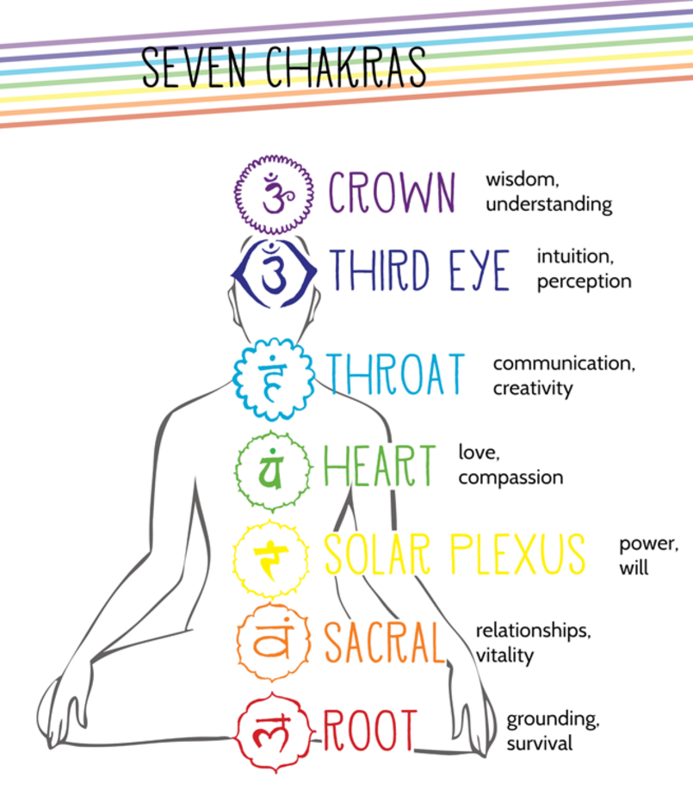
They are:

