Slide 1
Symbolic language in the book

Slide 2
When talking about symbolism, we have to refer to the book of revelation. That book is from the kabbalah which is eastern mysticism, nothing in that book is literal, they are all symbolic, allegoric and parabolic. In short words, it is all about left and right side of the human hemisphere

Slide 3
The seven churches in the first chapters which represent the seven chakras taught by the ancient spiritual masters

Slide 4
The ancient masters taught that there are seven nerve centers that run up your spine and these were the seven seals that you have to open or overcome in order to reach the high holy place which is the crown chakra. By getting to the pineal gland of the brain, the right hemisphere of the brain will be opened

Slide 5
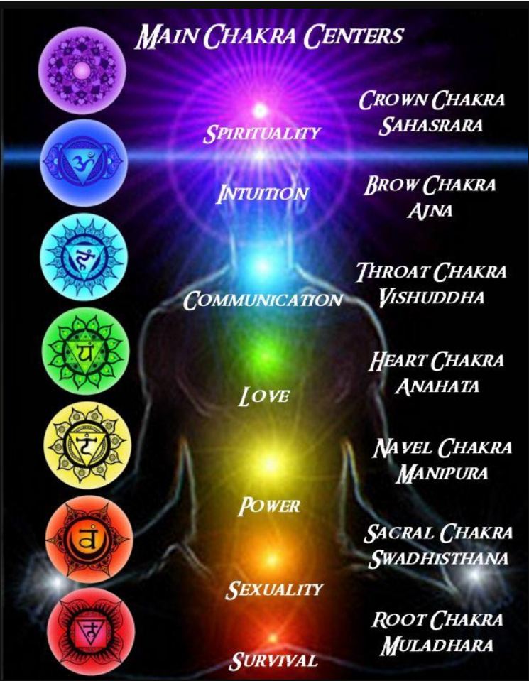

Slide 6
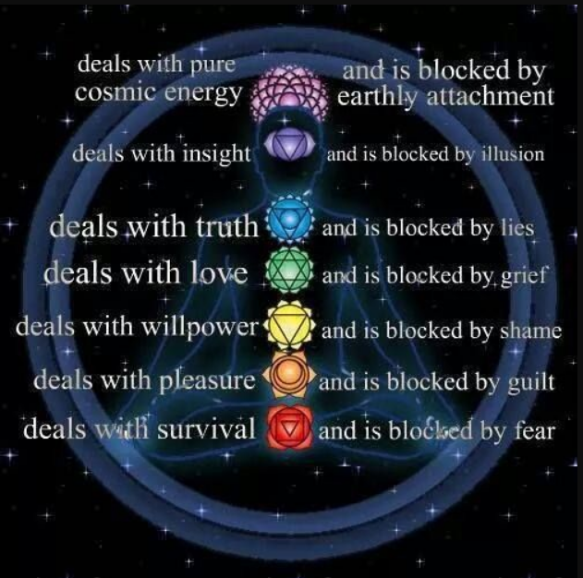

Slide 7
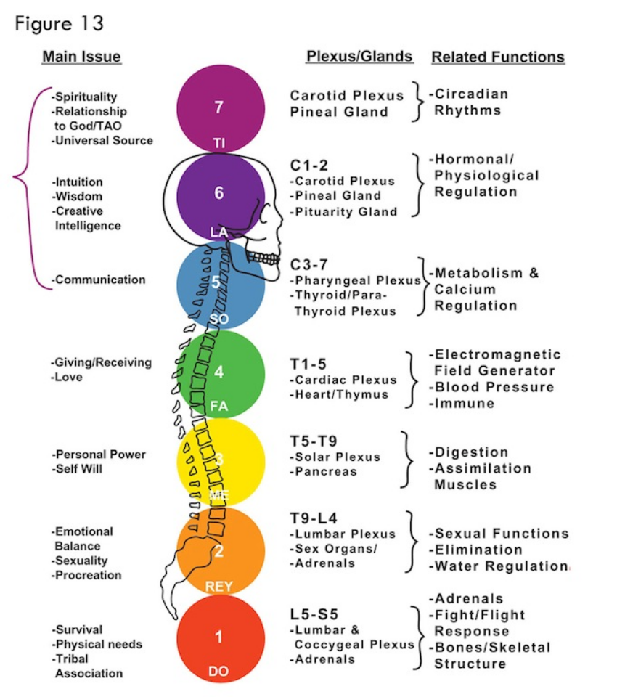

Slide 8
There are seven chakras which the bible calls seven churches, seven seals, seven turns of the walls of Jericho etc…

Slide 9
When the pineal gland is open, it lights up the right hemisphere of the brain.
The seven chakras or energy centers, is the kingdom of Elohim within you

Slide 10
The ancient masters called the Christ, Kundalini, they taught that it is the electro-magnetic feeling that lies down in the sacrum, when it is activated, it gives you a serpent feeling. It goes down to your root chakra first and moves up to every other chakra in a serpent motion until reaching the crown chakra

Slide 11
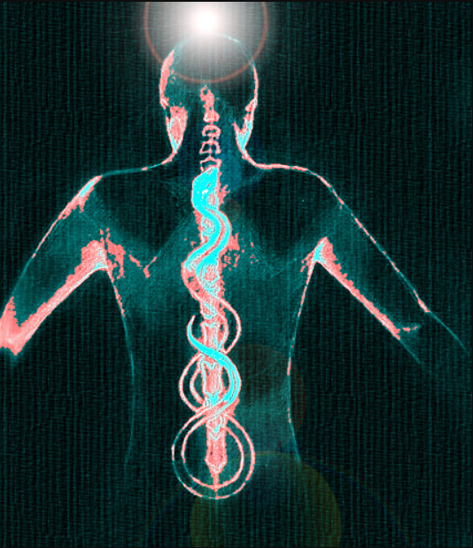

Slide 12
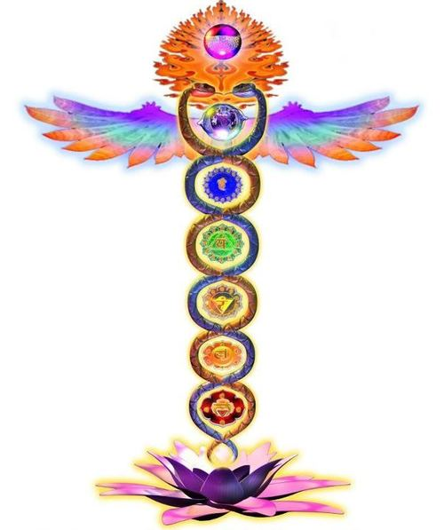

Slide 13
Let’s read how Kundalini energy is described in Revelation 5:1 Then I saw in the right hand of the one who sits on the throne a book written on the inside and on the outside (ὄπισθεν= on the back side), sealed with seven seals----- Puis je vis dans la main droite de celui qui était assis sur le trône un livre écrit en dedans et en dehors, scellé de sept sceaux

Slide 14
right hand------right hemisphere of the brain.
who sits on the throne------Higher consciousness.
a book written on the inside----in you.
On the back side--------------the back of the spine.
Sealed with 7 seals-------------7 chakras or the seven nerve centers that the electrical energy moves up to open the right hemisphere of the brain, as soon as it reaches the third eye chakra and opens it up.

Slide 15
Let’s read Rev. 3:7 The holy one, the true, who holds the key of David, who opens and no one shall close, who closes and no one shall open---- Écris à l'ange de l'Église de Philadelphie: Voici ce que dit le Saint, le Véritable, celui qui a la clef de David, celui qui ouvre, et personne ne fermera, celui qui ferme, et personne n'ouvrira

Slide 16
Philadelphia here is not the Philadelphia in Pennsylvania.
This Philadelphia is your 6th chakra, your pineal gland. It is your conscious center.
It is the area of the pituitary gland of the body and later one we will see that the bible talks about the master builder of the temple.
The master builder of the temple is the master gland of your brain which is the pituitary gland (in French: la glande pituitaire)

Slide 17
What I would like you to understand, there is no Yahweh who will give you, talk to you or touch you by simply asking in prayers like you have been taught

Slide 18
Everything is within you and Yahweh is you and you are Yahweh.
Your body is the incarnation of The Spirit of Yahweh.
You have the power to activate Yahweh in you

Slide 19
Your left side of your brain is the intellectual side, your carnal side, that side gives you only 10% of your human potential and the right side which is the spiritual side, the residence of Yahweh, that side when activated, you have 90% of your human potential. You become super human, or super natural. You dominate everything you lay your mind on

Slide 20
When people are talking about tithe. That has nothing to do with just money, it is everything you do with your left brain. That’s the highest portion a human can use of his brain

Slide 21
That is originated when Abraham gave it to Melchisédek which is consciousness.
Melchisédek was not a human being, it is an allegoric teaching. Melchisédek was not born, he had no mother, no father and He was king of Jerusalem

Slide 22
Melchisedek represents Christ consciousness, Nirvana, buddhic consciousness and you cannot give anything to someone that has no father, no mother, never was born, never dies it is just ridiculous to believe such person exist besides High consciousness, source of all creation, source of all power

Slide 23
When you pay 10% of your money here, we pay bills with it and help some people who are in need.
When Abraham paid the 10% to Melchisedek, if he was a person what did he do with that money when he was not human. Why would spirit need money for?
This Melchisedek represents The Higher power, whom has no beginning, no end. He is the spiritual realm

Slide 24
Paying tithe is to pay 10% of your mind to the higher power so you can receive 90% from Him.
You can only do that in meditation when you short it down.
Why was it symbolized this 10% when they tithe in the ancients, it was not money, but literally they always gave herbs.

Slide 25
They gave herbs which that grows out of the earth.
Why did they give herbs?
Because herbs represent your lower mind. what you have to tithe is what grows out of your lower mind. They are your thoughts. That’s why Yahshua said in Matthew 6, five times “Take no thoughts”. People translate by “Don’t worry” and which is impossible, as a human, you will always worry about many things. Bills, sicknesses, exams, etc

Slide 26
Even you hear all over soon the grinding of the tires of a car, in a second you will be worried.
While driving and stumble on a car accident, you are worried for a few seconds.
Yahshua never said, ‘Don’t worry. But take no thoughts

Slide 27
And you can only do that in meditation.
When you can short down your mind for a few minutes, you will feel, see and hear things. Because all the frequencies are trying to make connection with you.

Slide 28
When Yahshua said take no thoughts, he was saying that it is time to tithe, meaning relax, disconnect yourself to all the earthly thoughts. All the thoughts of the lower mind which are: fear, hate, criticism, division words, anger, lust etc… all the thoughts that get you in trouble

Slide 29
This is called tithing to Melchisedek.
You can do it by obeying the teaching of Yahshua. He wants you to meditate, to practice your single eye. He wants you to allow your lower consciousness to rise to the high consciousness

Slide 30
The angel of Philadelphia, it is the divine portion of your mind. It is your sixth chakra, go to your book and open it to Revelation 1:11

Slide 31
The seven churches represent the seven chakras that are sealed in your spine and only you, can break the seals to get to your father.
When you see in the book the seven days that Joshua had to march around Jericho and the walls fell down

Slide 32
There were no guys marching around seven times because he was at war. Paul said in Gal. 4:24 it was allegoric. It simply a figure speech to teach.
All it is said here, when Joshua marched around 6 times, nothing happened until he did it 7 times and that is when the wall fell down

Slide 33
Meaning to reach the father, to get access to your heaven, you have to open all the seven seals in meditation.
That is mysticism, allegorical, symbolic, figure speech.
There is wall between your lower mind and your higher mind, you have to march around that wall seven times until you bring it down. When that happen, you will be one with the divine consciousness

Slide 34
Let’s read Rev. 3:7 To the angel of the church in Philadelphia, write this:“The holy one, the true, who holds the key of David, who opens and no one shall close, who closes and no one shall open---- Écris à l'ange de l'Église de Philadelphie: Voici ce que dit le Saint, le Véritable, celui qui a la clef de David, celui qui ouvre, et personne ne fermera, celui qui ferme, et personne n'ouvrira

Slide 35
1- The word holy, what that means?
a) This word has to do with meditation, a human spirit is different than a holy spirit.
b) Your human spirit is stained with thoughts of all kind.
c) But the holy spirit is unstained by human thoughts, it is pure.
d) You get to the Holy Spirit when there are no human thoughts, only and exclusively divine thoughts

Slide 36
“Who holds the key of David”.
What that means?

Slide 37
a) The key of David comes from the teaching of the kabbalah, the ancient eastern of mysticism.
b) The kabbalah was written by the Jewish rabbis who had been exposed from people who had migrated from India who were part of the Buddhist faith

Slide 38
The key of David means 3 things

Slide 39
Adam, David
and Messiah

Slide 40
In 1 Cor. 15:45 So, too, it is written, “The first man, Adam, became a living being,” the last Adam a life-giving spirit--------- C'est pourquoi il est écrit: Le premier homme, Adam, devint une âme vivante. Le dernier Adam est devenu un esprit vivifiant

Slide 41
a) The key of David comes from the teaching of the kabbalah, the ancient eastern of mysticism.
b) The kabbalah was written by the Jewish rabbis who had been exposed from people who had migrated from India who were part of the Buddhist faith

Slide 42
2- The second part of key of David is David himself.
a) DAWID in Hebrew means war.
b) That is that part of your mind that is struggle with the flesh to conquer everything

Slide 43
c) David was constantly in war.
d) That is that part of your mind always waring against yourselves, waring against desires, waring against people around you

Slide 44
3- Let’s see something very interesting about David. In 2 chronicles, it says it was in the heart of David to build the temple the house for the name of Elohim of Israel---- David, mon père, avait l'intention de bâtir une maison au nom de Yahweh, Elohim d'Israël

Slide 45
a) David had in his mind to build the temple, but why couldn’t he do it?

Slide 46
1 kings 5:3 You know my father David was not able to build a temple for the name of Yahweh his Elohim. This was because of the warfare all around him until Yahweh put his enemies under his feet--- Tu sais que David, mon père, n'a pas pu bâtir une maison à Yahweh, son Elohim, à cause des guerres dont ses ennemis l'ont enveloppé jusqu'à ce que Yahweh les eût mis sous la plante de ses pieds

Slide 47
b) David could never build the temple because he was constantly at war. That is the symbol meaning of your lower aspect of your mind, as long as you are struggle with things around you, you can never build the temple which is inside of you.

Slide 48
c) You will never build it until you overcome the wars that rage inside of you. The wars are all the time you spend in pleasing people around you, pleasing yourself, listening to traditions of human made

Slide 49
d) You have to do this, you have to do that, you are completely confused, at the end you simply do not know what to do anymore, what you did yesterday which pleased that person, today the same person whom told you thank you very much because he was pleased and today that same person uses it against you to hurt your feelings by showing you, it was nothing.

Slide 50
e) With so many wars, you cannot build the temple. I overheard someone told his wife that because they are married, wives should not go out on the street without her husbands. That is just crazy and insane

Slide 51
D- Who built the temple, David’s son Solomon?
1- Solomon in Hebrew means man of peace.
2- That’s why Yahshua says “take no thoughts”
3- Meaning be peaceful when you enter the meditation chamber

Slide 52
4- Leave all human thoughts outside of the room.
5- Be humble means, leave behind, all human thoughts.
a) When you are there, you are not man or woman.
b) When you are at peace than you will find the temple

Slide 53
The third part of the key of David is “The Messiah”

Slide 54
1- In John 4:24 The woman said to Him, “I know that The Messiah is coming” (who is called Christ). “When He comes, He will explain everything to us----------- La femme lui dit: Je sais que le Messie doit venir (celui qu'on appelle Christ); quand il sera venu, il nous annoncera toutes choses

Slide 55
2- The third part of the key of David is the second coming of Christ.
a) That is the mind of Christ, the desire for high consciousness

Slide 56
b) The first coming is to teach you how to get to the father. With human consciousness, you can never get there. But with the manifestation of Christ consciousness, with practice you will be there soon. That is when you stop all the wars around you, when you finally find the peace with yourself, then you will be one with your Father.

Slide 57
May The source of all energy allow your right hemisphere to be activated

